Slide 1

Snake! Game Implementation on FreeRTOS and STM32F746ZG

Slide 2
CET341 - Real-Time Operating Systems for Embedded Microcontrollers Prepared by: Neil Cabrera Under the guidance of: Dr. Tang Liang Dr. Tang Liang
08 November 2019

Slide 3
Table of Contents
Project Introduction
Implementation
Validation and Demo
Conclusion

Slide 4
Project Introduction

Slide 5
Project Requirements
Nucleo
STM32F746
FreeRTOS
Input/Output
Extra Features

Slide 6
Implementation

Slide 7
Hardware Configuration
System Core
Cortex M7
GPIO
Connectivity
SPI
Security
RNG
Computing
NVIC
RCC
CRC
Extras
Joystick
MP3 IC
IO Shield

Slide 8
Hardware Configuration
Cortex M7
Set to run at maximum frequency of 216 Mhz
ART, D-Cache and I-Cache were all enabled
Connectivity
SPI was used to interface with ST7735R TFT-LCD
Security
Used RNG to generate random coordinates for the snake food to appear
Extras
Used joystick to provide input for the Snake Movement as well as to Start the game
A separate board with built-in MP3 player was used to provide sound effects to the game

Slide 9
FreeRTOS Implementation
Tasks
Idle Task
System Init Task
Game Running Indicator Task
Game Over Indicator Task
Snake Task
Game Progress Task
Interrupts
SysTick
GPIOE (Ports 4 & 12-15)

Slide 10
Demo

Slide 11
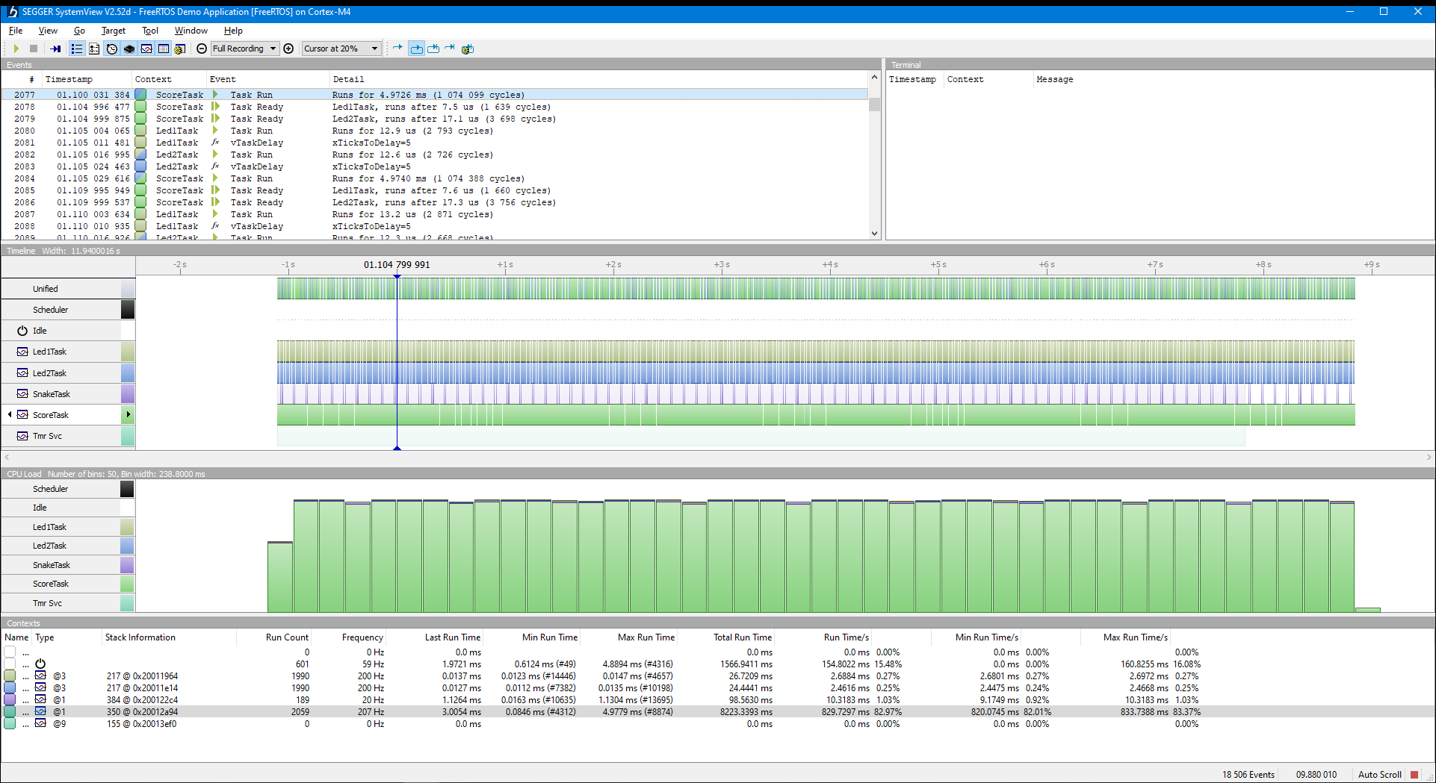
Validation using SystemView

Slide 12
Conclusion

Slide 13

Problems Encountered
Error due to NVIC for GPIOE (Navigation Controls) not enabled
Incorrect Time Slice setting causes the SnakeTask to have Timing Violations (Snake becomes fragmented in the screen)

Slide 14
Lessons Learned
Running the MCU at 216Mhz provides plenty of computing power to do simple tasks
Tasks can be timing sensitive

Slide 15
Thank You

